Slide 1
NoSQL
Lecturer: Ngo Huy Bien
Software Engineering Department
Faculty of Information Technology
VNUHCM - University of Science
Ho Chi Minh City, Vietnam
nhbien@fit.hcmus.edu.vn

Slide 2

Objectives
To select appropriate database tools for an enterprise system.

Slide 3

Contents
Why Relational Databases
Why Not Relational Databases
Data Models
Relational Data Model
Aggregate Data Models
Key-Value Databases
Document Databases
Column-Family Models
Demo

Slide 4

References
Pramod J. Sadalage and Martin Fowler (2012). NoSQL Distilled: A Brief Guide to the Emerging World of Polyglot Persistence. Addison-Wesley Professional.

Slide 5

Memory vs. Files vs. Databases [1]
Main memory is both limited in space and loses all data when you lose power or something bad happens to the operating system.
The database allows more flexibility than a file system in storing large amounts of data in a way that allows an application program to get at small bits of that information quickly and easily.

Slide 6
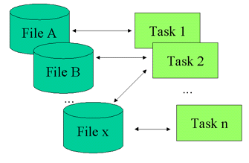
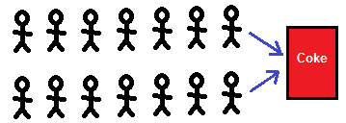
Why Relational Databases? (I)
Since enterprise applications can have lots of users and other systems all working concurrently, there’s a lot of room for bad things to happen.
Relational databases help handle this by controlling all access to their data through transactions.
Transactions also play a role in error handling.
With transactions, you can make a change, and if an error occurs during the processing of the change you can roll back the transaction to clean things up.

Slide 7
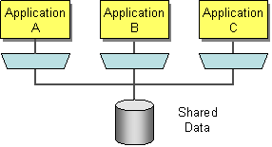
Why Relational Databases? (II)
Applications often need to use the same data and updates made through one application have to be visible to others.
A common way to do this is shared database integration where multiple applications store their data in a single database.
Using a single database allows all the applications to use each others’ data easily, while the database’s concurrency control handles multiple applications.

Slide 8
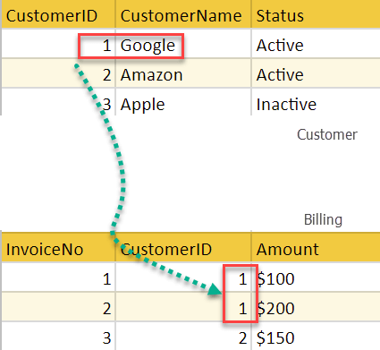
Why Relational Databases? (III)
Developers and database professionals can learn the basic relational model and apply it in many projects.
Although there are differences between different relational databases, the core mechanisms remain the same: Different vendors’ SQL dialects are similar, transactions operate in mostly the same way.

Slide 9
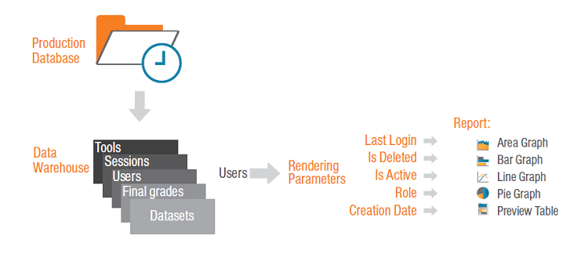
Why Relational Databases? (IV)
The ability to create meaningful information by joining the tables (aka reporting).
Eliminate data redundancy.
Just add columns because we can easily remove or change them later if necessary.

Slide 10
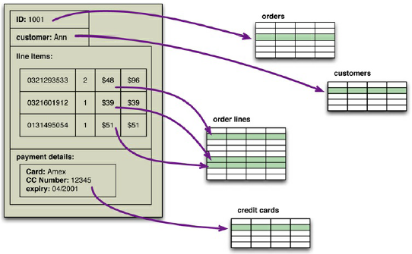
Why Not Relational Databases (I)
The impedance mismatch is the difference between the relational model and the in-memory data structures.
The relational data model organizes data into a structure of tables and rows, or more properly, relations and tuples.
The values in a relational tuple have to be simple—they cannot contain any structure, such as a nested record or a list.
If you want to use a richer in-memory data structure, you have to translate it to a relational representation to store it on disk.
→ More development effort.

Slide 11

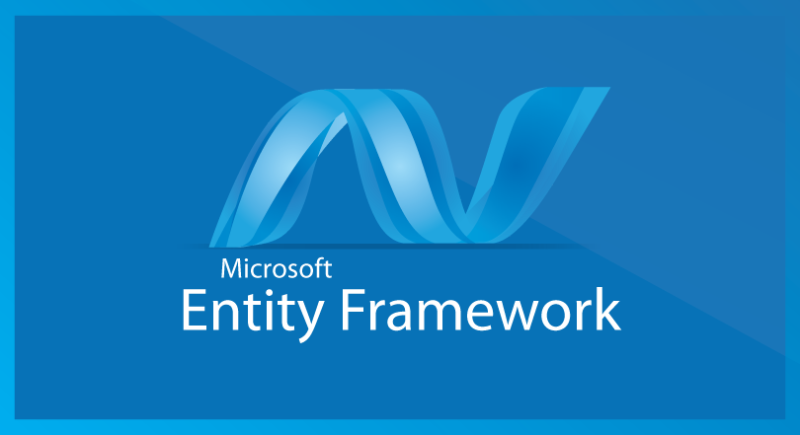
Why Not Relational Databases (II)
Impedance mismatch has been made much easier to deal with by the wide availability of object-relational mapping frameworks, such as Hibernate and iBATIS that implement well-known mapping patterns, but the mapping problem is still an issue.
Object-relational mapping frameworks remove a lot of grunt work, but can become a problem of their own when people try too hard to ignore the database and query performance suffers.

Slide 12
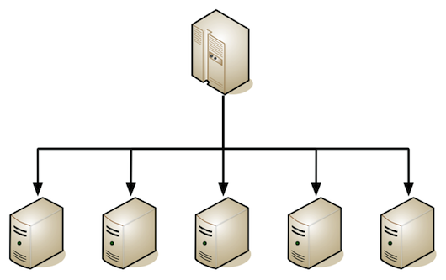
Why Not Relational Databases (III)
Coping with the increase in data and traffic required more computing resources.
Relational databases are not designed to be run on clusters.

Slide 13
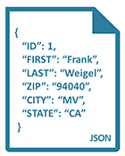
Why Not Relational Databases (IV)
When you want to store data in a relational database, you first have to define a schema—a defined structure for the database which says what tables exist, which columns exist, and what data types each column can hold.
Before you store some data, you have to have the schema defined for it.
With a schema, you have to figure out in advance what you need to store, but that can be hard to do.
There was a need for systems that could work with different kinds of data formats and sources without requiring strict schema definitions up front, and do it at scale.

Slide 14


Slide 15
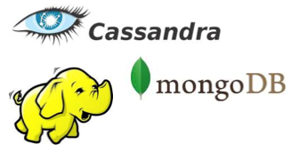
What is NoSQL?
NoSQL is an accidental neologism.
There is no prescriptive definition—all you can make is an observation of common characteristics.
The common characteristics of NoSQL databases are
Not using the relational model
Running well on clusters
Schemaless
Open-source
Built for the 21st century web estates
The most important result of the rise of NoSQL is Polyglot Persistence — using different data stores in different circumstances.

Slide 16
Relational Data Model
A data model is the model through which we perceive and manipulate our data.
This is distinct from a storage model, which describes how the database stores and manipulates the data internally.
The relational model takes the information that we want to store and divides it into tuples (rows).

Slide 17
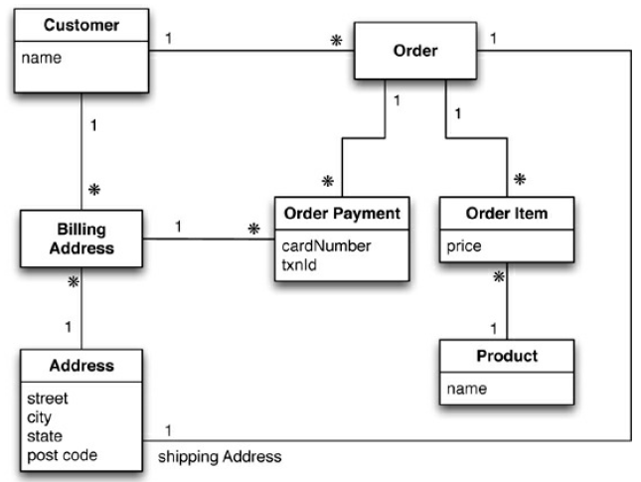
Relational Data Model Sample

Slide 18
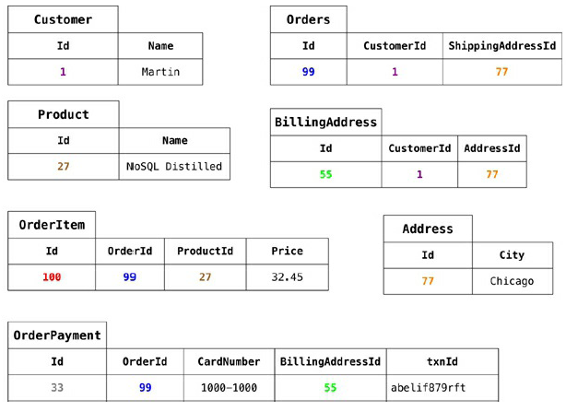
Typical Data

Slide 19
Aggregate Data Models
An aggregate is a collection of related objects that we wish to treat as a unit.
In particular, it is a unit for data manipulation and management of consistency.

Slide 20
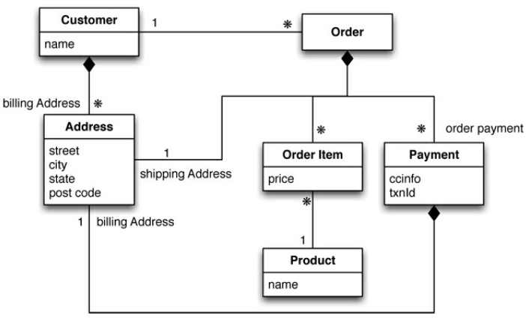
Aggregate Data Model 1
In this model, we have two main aggregates: customer and order.

Slide 21
Data Model 1: 2 Aggregates
// in customers
{
"id":1, "name":"Martin",
"billingAddress":[{"city":"Chicago"}]
}
// in orders
{
"id":99, "customerId":1,
"orderItems":[{
"productId":27, "price": 32.45,
"productName": "NoSQL Distilled"
}],
"shippingAddress":[{"city":"Chicago"}]
"orderPayment":[
{
"ccinfo":"1000-1000-1000-1000“, "txnId":"abelif879rft",
"billingAddress": {"city": "Chicago"}
}],
}

Slide 22
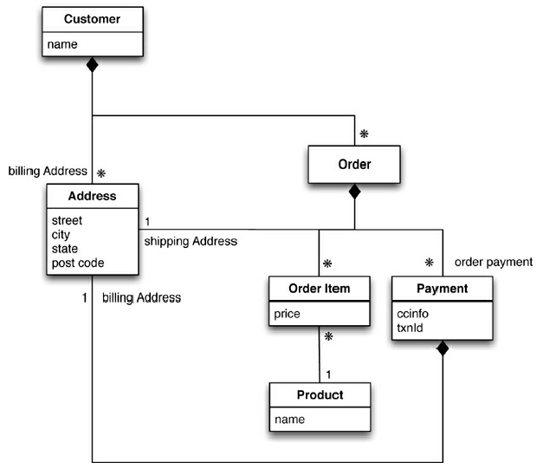
Aggregate Data Model 2
We could draw our aggregate boundaries differently, putting all the orders for a customer into the customer aggregate.

Slide 24
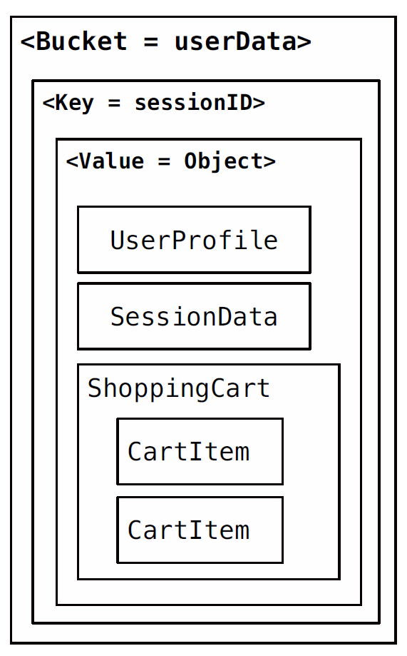
Key-Value Databases
Suitable use cases
Storing session information
Storing user profiles or preferences. Getting preferences of a user takes a single GET operation.
Storing shopping cart data.
When not to use
Having relationships between different sets of data, or correlate the data between different sets of keys.
Searching the keys based on something found in the value part of the key-value pairs.
Operating upon multiple keys at the same time.

Slide 25
Document Databases
Suitable use cases
Event logging, data for real-time analytics.
Publishing websites, managing user comments, user registrations, profiles, web-facing documents.
E-commerce applications often need to have flexible schema for products and orders.
When not to use
Data is saved in the form of application entities. If you need to query these entities ad hoc, your queries will be changing.
{
"firstname": "Pramod",
"citiesvisited": [ "Chicago", "London", "Pune", "Bangalore" ],
"addresses": [
{ "state": "AK",
"city": "DILLINGHAM",
"type": "R"
},
{ "state": "MH",
"city": "PUNE",
"type": "R" }
],
"lastcity": "Chicago"
}

Slide 26
Key-Value vs. Document Data Models
Key-value and document databases were strongly aggregate oriented.
Both of these types of databases consist of lots of aggregates with each aggregate having a key or ID that’s used to get at the data.
The two models differ in that in a key-value database, the aggregate is opaque to the database—just some big blob of mostly meaningless bits. In contrast, a document database is able to see a structure in the aggregate.
With a key-value store, we can only access an aggregate by lookup based on its key. With a document database, we can submit queries to the database based on the fields in the aggregate

Slide 27
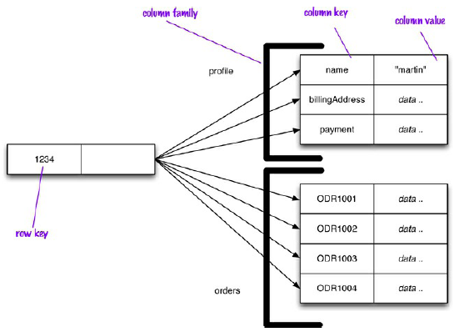
Column-Family Models
Column-family model is a two-level aggregate structure.
The first key is often described as a row identifier, picking up the aggregate of interest.
These second-level values are referred to as columns.
As well as
accessing the row as a whole, operations also allow picking out a particular column so to get a particular customer’s name:
get('1234', 'name')

Slide 28
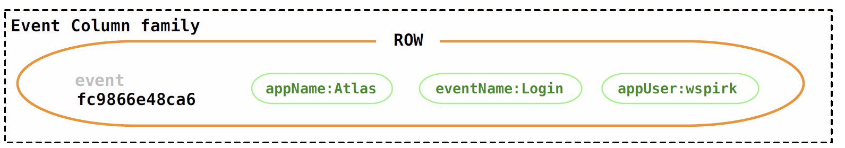
Cassandra
Suitable use cases
Since we can scale writes, Cassandra would work ideally for an event logging system.
Using column families, you can store blog entries with tags, categories, links, and trackbacks in different columns.
When not to use
Systems that require ACID transactions for writes and reads.
Aggregating the data using queries (such as SUM or AVG).
During the early stages, we are not sure how the query patterns may change, and as the query patterns change, we have to change the column family design.
//column family
{
//row
"pramod-sadalage" : {
firstName: "Pramod",
lastName: "Sadalage",
lastVisit: "2012/12/12"
}
//row
"martin-fowler" : {
firstName: "Martin",
lastName: "Fowler",
location: "Boston"
}
}

Slide 29
Tools
https://cassandra.apache.org/
https://www.mongodb.com/
https://hbase.apache.org/
https://www.oracle.com/database/technologies/related/nosql.html
https://aws.amazon.com/dynamodb/
https://neo4j.com/

Slide 30
Demo
MongoDB
Bradshaw Shannon, Eoin Brazil and Kristina Chodorow (2019). MongoDB: The Definitive Guide - Powerful and Scalable Data Storage. O'Reilly Media.
Chapter 10. Setting Up a Replica Set
Chapter 15. Configuring Sharding
Casandara
Jeff Carpenter and Eben Hewitt (2020). Cassandra: The Definitive Guide - Distributed Data at Web Scale. O'Reilly Media.
Chapter 3. Installing Cassandra

Slide 32
Further Reading
Luc Perkins, Eric Redmond and Jim Wilson (2018). Seven Databases in Seven Weeks: A Guide to Modern Databases and the NoSQL Movement. Pragmatic Bookshelf.
Martin Kleppmann (2017). Designing Data-Intensive Applications: The Big Ideas Behind Reliable, Scalable, and Maintainable Systems. O'Reilly Media.
Alex Petrov (2019). Database Internals. O'Reilly Media.

Slide 33

Thank You & See You Again

